Slide 1

N1 Health Food Access analysis
ADDRESSING DIETARY NEEDS IN AT-RISK COMMUNITIES
Presenter & Data Scientist:
Todd Munyon
June 3rd, 2025

Slide 2
The challenge
Many urban communities across the US are facing significant health issues which are exacerbated by limited access to nutritious food - a key social determinant of health.
The goal of this analysis is to improve community health while making the Medicare Advantage plan more attractive to potential prospects.
Data sourced from:
- CDC (Centers for Disease Control and Prevention)
- USDA (US Department of Agriculture)

Slide 3

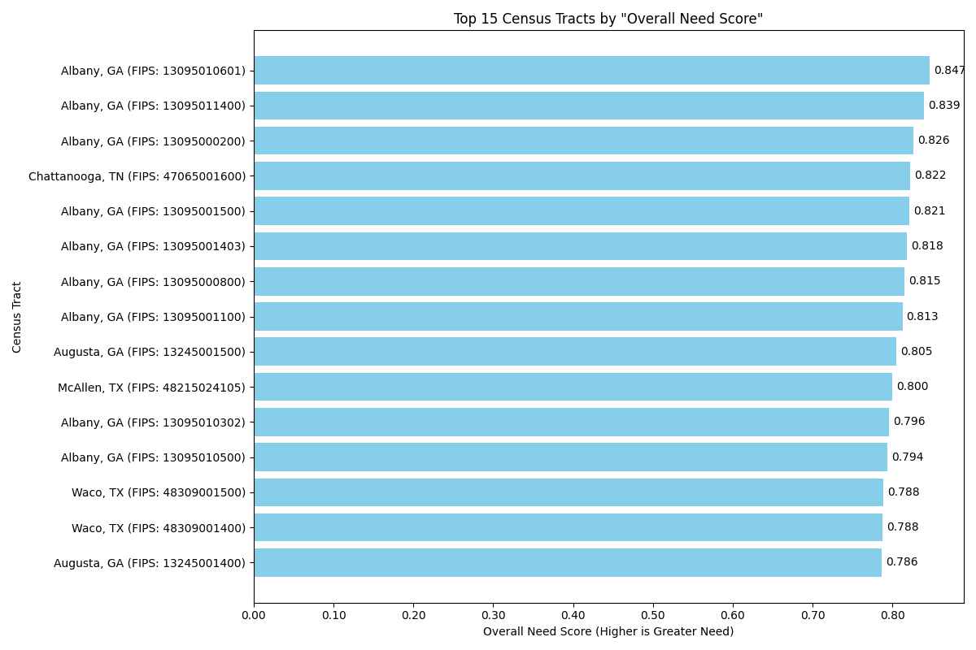
Greatest need
TOP PRIORITY AREAS
OVERALL NEED SCORE
=
HEALTH RANK
+
FOOD ACCESS RANK

Slide 4
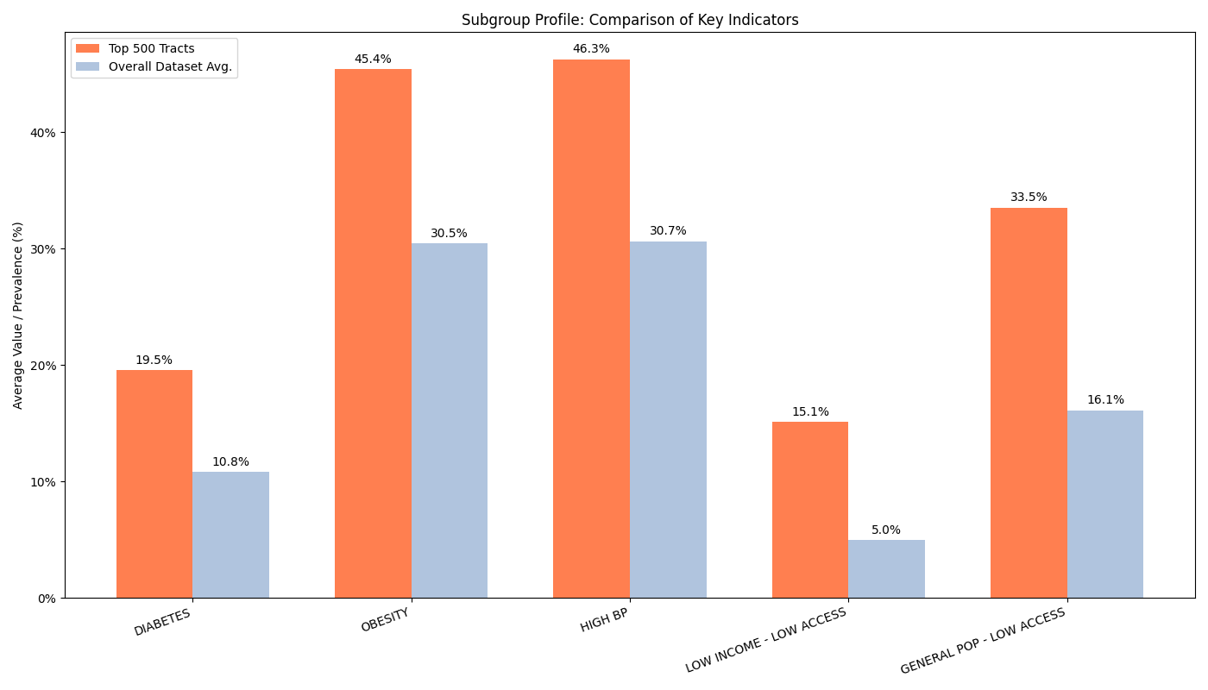
Subgroups
The Top-500 tracts
(2% of the overall) present a Diabetes rate ~81% higher than
the overall population
Low Income individuals in the Top-500 tracts present a ~200% increase in difficulty with food access
% Increases in Top-500
Obesity - 49%
High BP - 51%
Diabetes - 81%
LI – LA - 203%
GP – LA - 108%

Slide 5
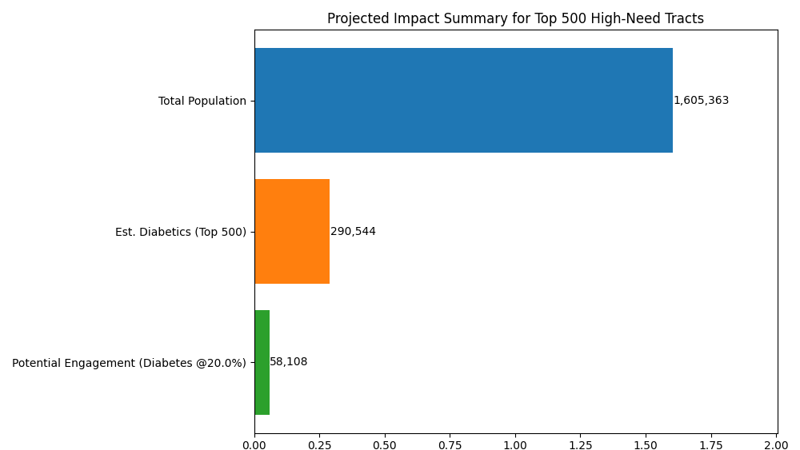
Impact & projected engagement

Slide 6

Conclusion
After extensive analysis, it's highly recommended to deploy targeted food access programs in the identified high-need census tracts.
Addressing these tracts will:
- Improve health outcomes for engaged individuals.
- Enhance value of the Medicare Advantage Membership plan.
- Create a stronger community presence for the healthcare system.

